Slide 1
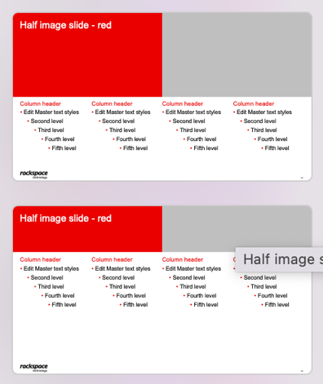
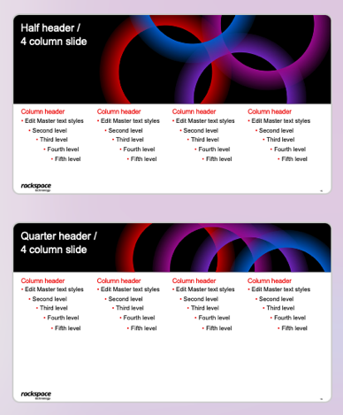
Welcome to the Rackspace Customer First – Cloud First template
When copying slides into this template you may need to reapply the masters. If your content drastically changes when doing this, undo applying the master and choose the master that is the same but has “CLEAN” at the end of its name. Another option is to choose the “Title Only” master.
This may or may not give better results, it all depends on how the original was created. It does work well with slides using the masters shown here. After applying the new master you will need to remove any photo that is still in the top right corner.

Slide 2
Azure Landing Zone Maturity Assessment
March 27, 2026
Upendra Kumar
Delivery Architect

Slide 3
Clear Objectives Guided Our Evaluation
Baseline
Establish fact-based view of current Azure Landing Zone posture
Establish comprehensive fact-based view of current Azure Landing Zone posture across identity, networking, governance, security, operations, and DevOps capabilities
Identify gaps against Microsoft Cloud Adoption Framework best practices to highlight areas requiring immediate investment
Provide baseline maturity score for objective tracking of improvements and strategic roadmap planning initiatives
Enable informed decision-making by articulating limitations, requirements, and business impact of addressing gaps
Benchmarking
Identify gaps against Microsoft Cloud Adoption Framework best practices
Scoring
Provide maturity score to guide future roadmap planning
Enablement
Enable informed decision-making for platform modernization

Slide 4
Comprehensive Scope and Rigorous Methodology
7
CAF
Core Areas Evaluated
Microsoft CAF Framework Applied
Scope Covered:
Methodology Applied:
Azure Billing and Active Directory foundation providing enterprise identity and cost management baseline
Identity and Access Management controls governing user authentication, authorization, and privilege elevation
Network Topology and Connectivity architecture including hybrid connectivity and security enforcement
Resource Organization, Governance policies, Security posture, and Platform Automation maturity
Microsoft Azure Landing Zone Review standardized questionnaire administered through collaborative workshop sessions
Real-time validation using Azure Portal to confirm current state configurations and verify responses
Automated scoring engine with pillar-wise maturity evaluation generating objective assessment results

Slide 5
Centralized Operating Model Limits Agility
Centralized Control Model
Limited Self-Service
Maturity View
Current State
Operating model aligns with early cloud adoption but creates bottlenecks limiting organizational agility
As workload diversity increases, this model will constrain business responsiveness and create unsustainable operational overhead
Centralized teams manage all core networking, security controls, and shared platform services for the entire organization
Application teams depend on central approval workflows and manual provisioning for infrastructure changes and deployments

Slide 6

Identity Security Gaps Create Elevated Risk
MFA Enabled
Zero
No PIM
Conditional Access Policies
Implementation
for All Users
Entra ID synchronized with on-premises AD provides unified identity with MFA enabled, establishing baseline authentication security [1]
Critical gaps: no Conditional Access policies, no Privileged Identity Management, and no emergency break-glass accounts configured [1]
RBAC assignments mix individual users with security groups without consistent governance, limiting granular permission controls [1]
Identity gaps create elevated risk through over-privileged access and insufficient privilege governance, enabling potential unauthorized access [1]

Slide 7
Topology
Hub-and-Spoke with Virtual WAN
Strong Network Foundation with Optimization Opportunities
Connectivity
Hub-and-Spoke architecture using Azure Virtual WAN provides scalable foundation for multiple virtual networks and branch connectivity with centralized routing and security policy enforcement
Cisco Meraki SD-WAN and Palo Alto NVAs deliver connectivity with Azure Firewall Premium centrally managed, providing comprehensive network security inspection and threat protection
Design lacks Azure ExpressRoute private connectivity and Azure-native VPN gateways, relying on third-party network virtual appliances for hybrid connectivity instead
Private Endpoints deployed selectively rather than consistently across all Azure services, limiting full isolation from public internet exposure
Cisco Meraki SD-WAN and Palo Alto NVAs
Security
Azure Firewall Premium centrally managed
Private
Selective Private Endpoints usage

Slide 8
Manual Governance Creates Cost and Compliance Risks
Subscription-Level Cost Tracking Only
No Mandatory Tagging
Manual Subscription Provisioning
Cost tracking implemented only at subscription level without granular resource visibility or tags, limiting chargeback capability
No mandatory tagging or Azure Policy enforcement for consistent metadata, reducing efficiency and making compliance reporting difficult
Azure Advisor recommendations not proactively reviewed, resulting in missed cost optimization and efficiency improvement opportunities
Manual subscription provisioning without Infrastructure-as-Code creates configuration inconsistencies and increases deployment time and error risk

Slide 9
Reactive Security Posture Limits Scale Protection
Current State
Risk Impact
Reactive security approach creates inconsistent security posture across resources due to time lag between detection and manual remediation. Limited Azure-native security enforcement through deny policies or auto-remediation prevents proactive threat prevention and increases window of vulnerability exposure. Manual remediation model cannot scale effectively as Azure resource count and workload complexity grows, creating unsustainable operational burden and elevated security risk.
Trend Micro Monitoring Active
Manual Remediation Only
Trend Micro deployed for continuous security posture monitoring and compliance checking across AGI's Azure environment. Security findings and policy violations monitored through Trend Micro console but not automatically enforced or remediated through Azure-native controls. Remediation actions performed manually by InfoSec team through Azure Portal on case-by-case basis without automated workflows or policy-driven enforcement capabilities.

Slide 10
Limited Automation Increases Operational Overhead
No centralized DevOps framework established, resulting in inconsistent deployment practices and limited infrastructure standardization
Infrastructure changes performed manually through Azure Portal rather than automated Infrastructure-as-Code approaches
CI/CD pipelines not standardized across teams, limiting deployment velocity and preventing modern software delivery practices
High operational overhead from manual processes reduces team productivity and creates compliance challenges

Slide 11

Critical Gaps Require Strategic Investment
5
Immediate
High-Priority Gap Areas
Investment Required
Lack of centralized logging infrastructure and SIEM creates security blind spots preventing effective threat detection and incident investigation [1]
No identity privilege elevation controls through PIM allows persistent standing admin access, violating least privilege and increasing credential theft risk [1]
Manual governance and subscription provisioning without Azure Policy or IaC creates inconsistencies, slows deployment, and prevents scalable platform management [1]
Inconsistent resource tagging and subscription-level cost tracking eliminates ability to accurately allocate spending, causing cost leakage and missed optimization [1]
Limited platform automation and DevOps maturity with manual infrastructure changes reduces repeatability and prevents modern cloud-native deployment practices [1]

Slide 12
Executive Risk Summary
Area | Risk
Identity | Over-privileged standing access without just-in-time controls increases credential theft risk and delays detection of unauthorized privilege escalation attempts
Governance | Lack of policy-driven enforcement and automated standards enables configuration drift, resource sprawl, and cost leakage without visibility or control mechanisms
Security | Reactive manual remediation approach cannot scale with growing attack surface, increasing mean-time-to-respond and creating inconsistent security posture across resources
Operations | Manual provisioning and fragmented monitoring creates unsustainable operational burden, limiting platform team scalability and reducing service reliability
DevOps | Slow portal-based deployment model without Infrastructure-as-Code reduces business agility, increases human error risk, and prevents modern software delivery practices

Slide 13
Key Strengths Provide Solid Foundation
Foundation
Functional Azure Landing Zone deployed
Functional Azure Landing Zone successfully deployed and operational with multiple subscriptions supporting production workloads
Centralized network security architecture implemented using Azure Firewall Premium provides advanced threat protection and consistent policy enforcement
Azure Virtual WAN deployment enables scalable hub-and-spoke connectivity architecture that can efficiently support additional networks and connections
Multi-factor authentication enforced across all user accounts establishes critical baseline identity security control reducing credential compromise risk
Security posture monitoring successfully integrated with Trend Micro platform provides continuous visibility into security findings and compliance status
Security
Centralized network security with Firewall Premium
Connectivity
Virtual WAN for scalable architecture
Identity
MFA enforced across all users
Monitoring
Security posture integrated with Trend Micro

Slide 14
Fragmented Observability Reduces Visibility
No centralized Log Analytics workspace deployed, resulting in siloed logging at subscription levels without unified visibility
Identity audit logs and sign-in activity not centrally monitored, creating security blind spots and limiting threat detection
Microsoft Sentinel SIEM platform not deployed, eliminating advanced threat detection and automated security response capabilities
Alerts configured only for selected workloads, resulting in inconsistent monitoring and delayed incident detection

